Slide 1
Electricity: The Linchpin of a Zero Emissions Economy
Energy Policy Roundtable in the PJM Footprint #15
December 18th, 2019
Ryan Jones, Co-founder

Slide 2

About Evolved Energy Research
Energy consulting firm focused on addressing key energy sector challenges posed by energy system transformation
Lead developers of EnergyPATHWAYS and RIO, two models used to investigate pathways to deep decarbonization
We advise clients on issues of policy implementation and target-setting, infrastructure investments, R&D strategy, technology competitiveness, and asset valuation

Slide 3
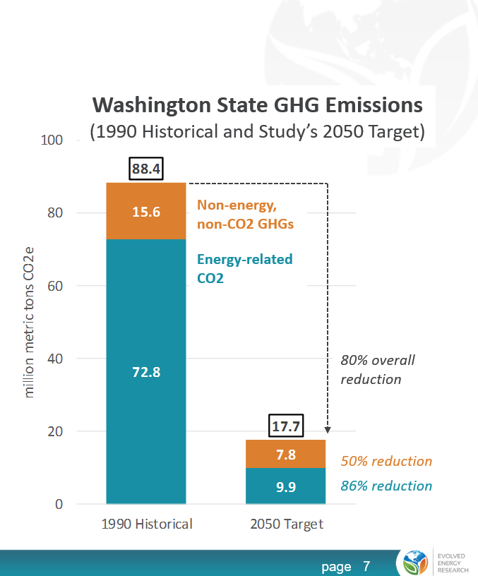

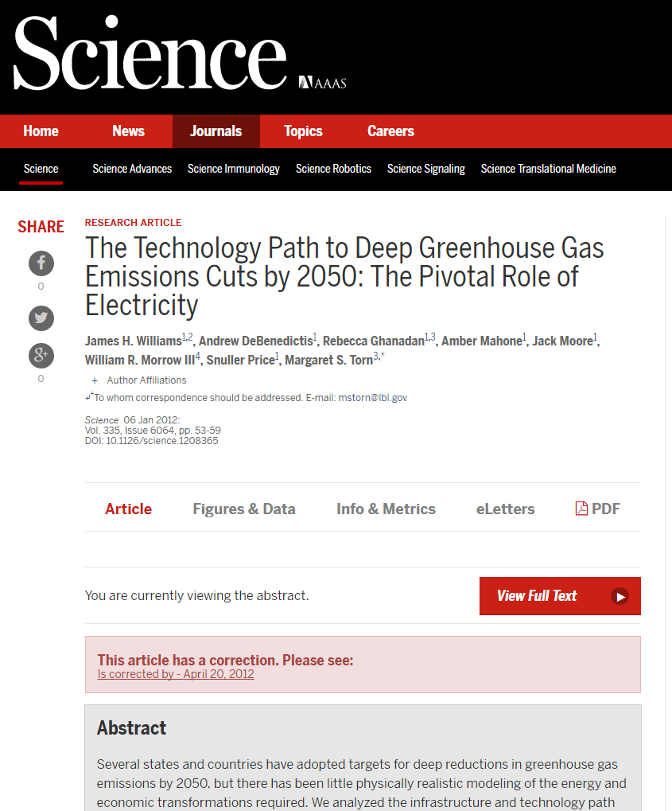



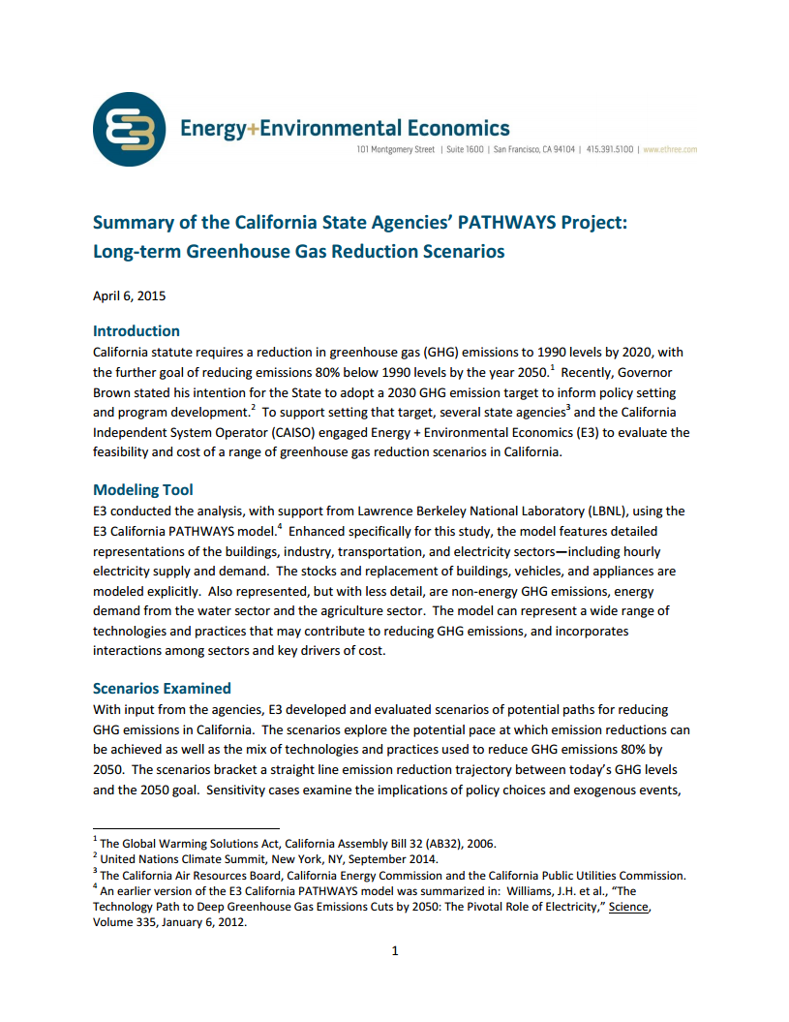

Links to recent work
Northwest Study for Clean Energy Transition Institute (2019)
Pathways to 350 ppm (2019)
NREL Electrification Futures Study & NARIS Study (2017-2018)
Washington State Deep Decarbonization report (2017)
Risky Business: From Risk to Return (2016)
PGE Decarbonization Study (2018)
Hydro-Quebec Northeast U.S. enhanced coordination study (2018)
Energy efficiency & flexible load valuation for DOE EPSA (2017)
Forthcoming studies for state of New Jersey, Princeton University, SDSN, WECC, Mexico, Florida, and Massachusetts

Slide 4
Zero-carbon energy system context
Importance of electrification
Role for electricity

Slide 5
Transitioning to a low-carbon energy system
Why is it so critical to think long term?
U.S. Energy-related CO₂ Emissions
Stock replacement count before mid-century
Bulb
Reference
Appliances
AC & Furnace
Dead-end pathway
Vehicles
Commercial boilers
Power plant
Pipelines
Low-carbon Target
2020
2030
2040
2050

Slide 6
Final energy demand in the U.S. Annual Energy Outlook
population and service demands grow
Increasing vehicle efficiency
Little to no fuel-switching in the AEO reference case
Note: Excludes energy from fossil extraction and refining. Service-demand from AEO 2019 but with some assumptions and technology differences.

Slide 7
Separating hydrocarbon final energy demands
22 quads of non-hydrocarbon final energy demands could be satisfied with zero carbon electricity
48 quads demand for hydrocarbons with the following solutions:
Drop-in fuel replacements
Efficiency, mode shifting, conservation
Emissions offsetting
Electrification

Slide 8
Option 1. Drop in fuel replacements
Conclusion: Biomass supplies are insufficient and large amounts of electricity derived fuels necessitates infeasible levels of electricity system growth
Electricity-derived fuels replace the residual?
Requires ~6 TW renewables or ~2.5 TW nuclear plus significant direct air capture (4x current U.S. generation) ***
U.S. maximum biomass supply*
Maximum fuel from biomass**
*** Assumes 50 efficiency from electricity to hydrocarbon, 50% solar and 50% wind with capacity factors of 50% and 30% respectively
*U.S. Billion Ton Study
**Assumes 50-60% conversion efficiency

Slide 9
Option 2. Efficiency, mode shifting, conservation
Conclusion: It is difficult to imagine more than a 30% reduction in energy demand coming from efficiency, mode shifting, and conservation by 2050
Low demand no fuel switch assumptions:
40% reduction in LDA miles traveled
20% reduction in most other service demands
Adoption of high-efficiency technologies across many subsectors

Slide 10
Option 3. emissions offsetting
Conclusion: Difficult to count on much over 1 Gt sequestration given capture potential, annual sequestration potential, and geographic mismatches
Total offset needed is ~3.5 Gt CO2
1-3 Gt CO2 Annual Sequestration Potential*
CO2 contained in 20 quads biomass (near technical potential)
Increasing cost and decreasing certainty
Minority are stationary and large enough to justify CC
Low-end estimate
1.9 Gt CO2 assuming
93.8 kg/mmbtu
*Greig C. 2019, Princeton University

Slide 11
Option 4. electrification
Conclusion: With high electrification, it is possible to reduce hydrocarbon final energy demand to <15 quads, which can then be successfully managed with strategies 1-3.
Efficiency of heat pumps and electric drive-train
70% reduction in hydrocarbon demand

Slide 12




Four pillars of deep decarbonization: U.S. Benchmarks
Electricity Decarbonization
Energy Efficiency
Electrification
Carbon Capture
95% reduction in emissions intensity
40% reduction in per-capita final energy demand
300% increase in share of energy from electricity
400 MMT+ carbon capture and use/storage

Slide 13







Three pillars of deep decarbonization (2014 DDPP reports)
China, India and United Kingdom
China
India
UK
Source: figures from Deep Decarbonization Pathways Project country reports (2015)

Slide 14
Infrastructure transition example: light-duty vehicles
Sales Shares
Stock
Energy Demand
Emissions
EV and HFC higher drive-train efficiency results in a drop in final-energy demand even though service demand is increasing
Decarbonizing electricity means emissions are reduced by over 95% by 2050
Stocks turn-over as vehicles age and retire making it necessary to increase sales shares early

Slide 15
Mid-Atlantic & Great Lakes regional example

Slide 16
Rates of electrification (Mid-Atlantic & Great Lakes)
High Electrification Benchmarks
50% of LDV sales → EV by 2030
50% of new building heating → HP by 2030
Electrify 90%+ of most stock by 2050
15 Year Saturation Delay Benchmarks
20% of LDV sales → EV by 2030
20% of new building heating → HP by 2030
Electrify 60%+ of most stock by 2050

Slide 17
Electricity load
Optimal capacity expansion in a system meeting a net-zero 2050 carbon constraint
National
Mid-Atlantic & Great Lakes
High Electrification
15 Year Saturation Delay
High Electrification
15 Year Saturation Delay
Slow electrification results in increased electricity generation

Slide 18
Electricity generation Mid-Atlantic & Great Lakes
Optimal capacity expansion in a system meeting a net-zero 2050 carbon constraint
High Electrification
15 Year Saturation Delay
% Low Carbon
Delay electrification
High electrification

Slide 19
Installed thermal capacity Mid-Atlantic & Great Lakes
High Electrification
15 Year Saturation Delay
Reduced heating & transportation loads result in smaller gas fleet
Hythane mixes of up to 60% + BECCS offsets results in overall growth in gas capacity without CC

Slide 20
Biomass use
Carbon sequestration
High Electrification
15 Year Saturation Delay
High Electrification
15 Year Saturation Delay
+25% biomass use
+40% sequestration

Slide 21
Conclusions
Electrification is an essential strategy for reaching a zero-carbon energy system
  Must be paired with rapid decarbonization of the electricity system
Lower rates of electrification result in more pressure on the electricity system, additional biomass use, additional carbon sequestration, & higher cost
The rates of electrification that give us the best chance of reaching a zero carbon energy system are extremely aggressive
  50% of new vehicle sales are electric in 2030
  50% of new building heating systems are heat pumps by 2030

Slide 23
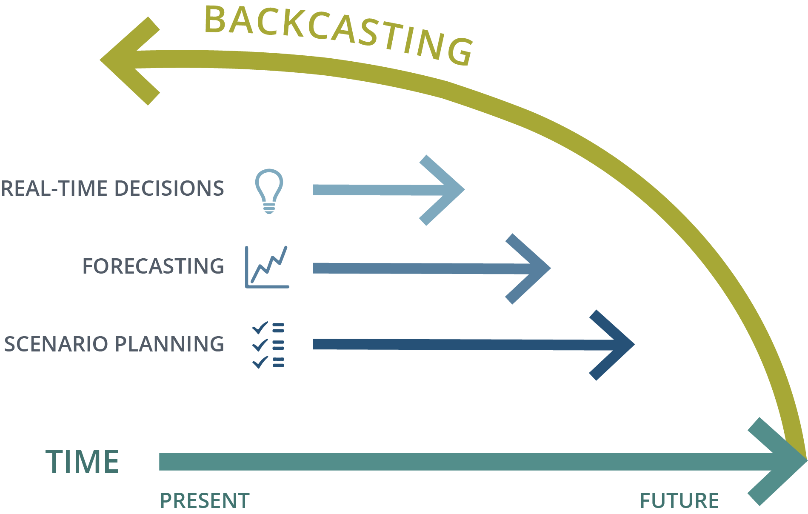
Creating a future energy system plan
Necessary to meet the level of granularity relevant for implementers (utilities, business community, regulators, citizens)
Approach is to start with the end-goal and work backwards to understand implications
  Understanding policy comes after understanding the physical transition
Figure source: https://www.backcastpartners.com/what-is-backcasting/

Slide 24


Modeling approach
Pairing EnergyPATHWAYS and RIO
Description
Scenario analysis tool that is used to develop economy-wide energy demand scenarios
Optimization tool to develop portfolios of low-carbon technology deployment for electricity generation and balancing, alternative fuel production, and direct air capture
Application
EnergyPATHWAYS (EP) scenario design produces parameters for RIO’s supply-side optimization:
Demand for fuels (electricity, pipeline gas, diesel, etc.) over time
Hourly electricity load shape
Demand-side equipment cost
RIO returns optimized supply-side decisions to EP:
Electricity sector portfolios, including renewable mix, energy storage capacity & duration, capacity for reliability, transmission investments, etc.
Biomass allocation across fuels

Slide 25
RIO decisions variables and outputs
Hours
24 hr * 40 – 60 sample days
= 960 – 1440 hr
Days
365 days * 1-3 weather years
= 365 – 1095 days
Years
30 yr study / 2 – 5 yr timestep
= 6 – 15 years
Decision Variables |  | Key Results
 | Generator Dispatch |  | Hourly Dispatch
 | Transmission Flows |  | Transmission Flows
 | Operating Reserves |  | Market Prices
 | Curtailment |  | Curtailment
 | Load Flexibility
Decision Variables |  | Key Results
 | Fuel Energy Balance and Storage |  | Daily Electricity Balances
 | Long Duration Electricity Storage |  | Daily Fuel Balances
 | Dual Fuel Generator Blends
Decision Variables |  | Key Results
 | Emissions from Operations |  | Total Annual Emissions
 | RPS Supply and Demand |  | RPS Composition
 | Capacity Build, Retirement & Repower |  | Incremental Build, Retirement, & Repower
 |  |  | Thermal Capacity Factors
 |  |  | Annual Average Market Prices
 |  |  | Marginal Cost of Fuel Supply

Slide 26
RIO considers investments and operations to find the least-cost, reliable system
Operations and investment decisions are co-optimized across the study period to find the optimal portfolio
Year Timesteps
2020
. . . . . . . .
2050
24 Hour Dispatch
40-60
Samples
. . . .
365 Days
Hour

Slide 27
Marginal system cost of different final-energy types
Incremental cost of consuming one more MMBtu in a net-zero energy system
Fuel type | 2020 marginal system cost | 2050 marginal system cost (net-zero) | Notes:
Liquid fuels | $18/MMbtu | $35/MMbtu | Higher refined product cost and higher fuel carbon content
Pipeline gas | $3.5/MMbtu | $15/MMbtu | Low cost and lower carbon content
Electricity | $7/MMbtu | $14/MMbtu | Electricity becomes relatively more competitive + highly efficient as a final energy type for mobility and low-temperature heating
+$17/MMbtu
+$12/MMbtu
+$7/MMbtu

Slide 28
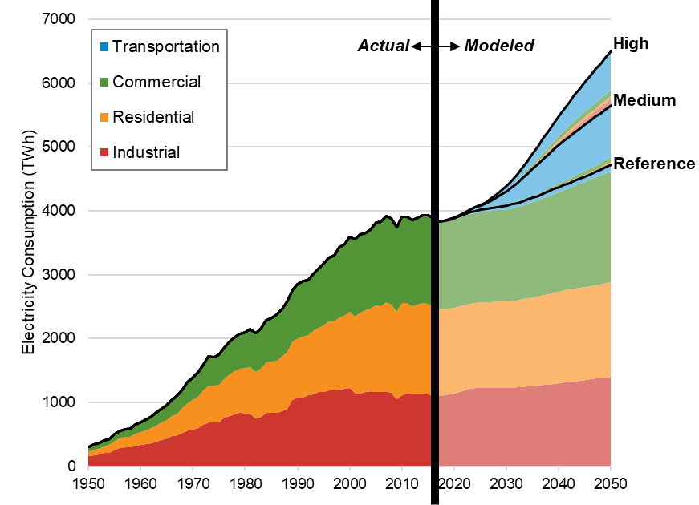
Electricity demand after high electrification
NREL Electrification Futures Study
AEO Reference
Deep Decarbonization Pathway
Excludes fossil extraction and refining

Slide 29
Rates of electrification for residential buildings

Slide 30
Rates of electrification for light duty vehicles
Sales Share
Stock
50% EV sales in 2030
100 million EVs in 2034
asdf
50% EV sales in 2037
100 million EVs in 2040
50% EV sales in 2044
100 million EVs in 2046

Slide 31
RIO & EP data and methods have improved across many past studies
Project | Geography |  | EP | RIO
Risky Business Project From Risk to Return | National | U.S./Census Division | x
National Renewable Energy Laboratory Electrification Futures Study | National | U.S./50 states | x
National Renewable Energy Laboratory North American Renewable Integration Study | National | Canada/Mexico | x
Our Children’s Trust 350 PPM Pathways for the United States | National | U.S./12 regions | x | x
Pathways for Florida (ongoing) | State | U.S./16 regions | x | x
Hydro Québec Deep Decarbonization in the Northeastern U.S. | Regional | Northeast | x
State of Washington: Office of the Governor Deep Decarbonization Pathways Analysis | State | WA | x
Confidential California utility Economy-wide GHG policy analysis | State/Utility Service Territory | CA | x | x
Clean Energy Transition Institute Northwest DDP Study | Regional | ID, MT, OR, WA | x | x
New Jersey Board of Public Utilities Integrated Energy Plan (ongoing) | State | NJ | x | x
Portland General Electric Deep Decarbonization Pathways Analysis | Utility territory | PGE | x
Confidential Environmental Organization Deep Decarbonization Pathways Analysis (ongoing) | National | US/14 Regions | x | x
Natural Resource Defense Council, Inc Deep Decarbonization Pathways Analysis (ongoing) | National | US/14 Regions | x | x
Princeton University Low-Carbon Infrastructure Project (ongoing) | National | US/16 Regions | x | x
Inter-American Development Bank Deep Decarbonization of Mexico | National | Mexico/5 Regions | x | x
Confidential Client Zero Carbon European Power Grid | Regional | EU/8 Regions |  | x
Confidential Client Low Carbon Electricity in Japan | National | Japan/5 Regions |  | x

Slide 32
Demand-subsectors
commercial air conditioning
commercial cooking
commercial lighting
commercial other
commercial refrigeration
commercial space heating
commercial ventilation
commercial water heating
district services
office equipment (non-p.c.)
office equipment (p.c.)
aviation
domestic shipping
freight rail
heavy duty trucks
international shipping
light duty autos
light duty trucks
lubricants
medium duty trucks
military use
motorcycles
passenger rail
recreational boats
school and intercity buses
transit buses
residential air conditioning
residential building shell
residential clothes drying
residential clothes washing
residential computers and related
residential cooking
residential dishwashing
residential freezing
residential furnace fans
residential lighting
residential other uses
residential refrigeration
residential secondary heating
residential space heating
residential televisions and related
residential water heating
Cement and Lime CO2 Capture
Cement and Lime Non-Energy CO2
Iron and Steel CO2 Capture
Other Non-Energy CO2
Petrochemical CO2 Capture
agriculture-crops
agriculture-other
aluminum industry
balance of manufacturing other
bulk chemicals
cement
computer and electronic products
construction
electrical equip., appliances, and components
fabricated metal products
food and kindred products
glass and glass products
iron and steel
machinery
metal and other non-metallic mining
paper and allied products
plastic and rubber products
transportation equipment
wood products
lime
EnergyPATHWAYS database includes 67 subsectors
  Primary data-sources include AEO 2019 input & output files, RECS, CBECS, MECS, SEDS, NREL
  8 industrial process categories, 11 commercial building types, 3 residential building types
  363 demand-side technologies w projections of cost (capital, instillation, fuel-switching, O&M) and service efficiency

Slide 33
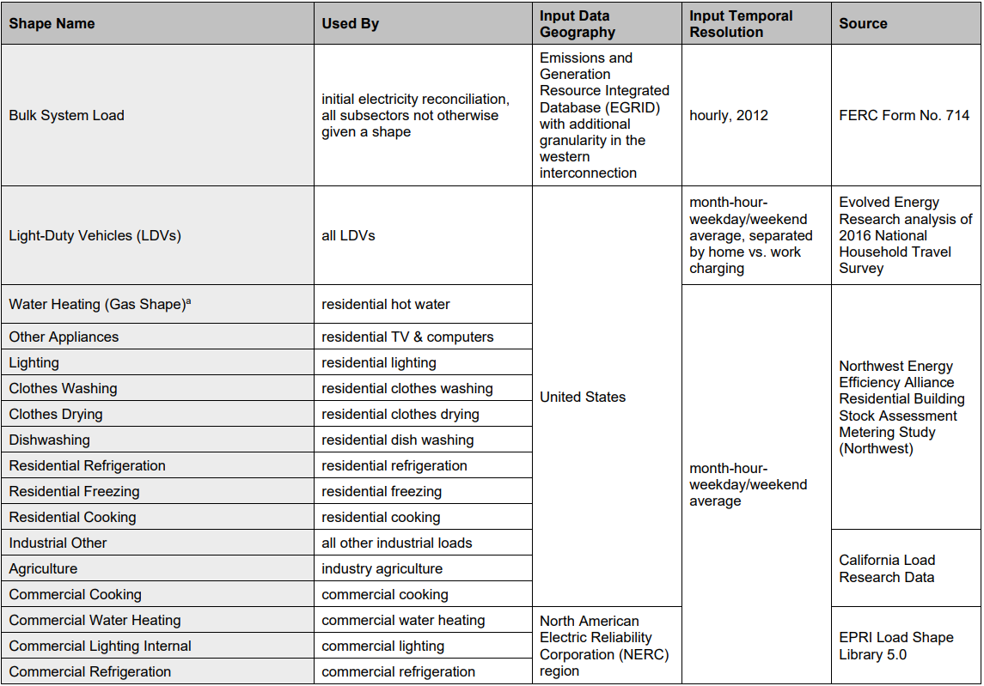
Load shape sources
List compiled for NREL EFS study

Slide 34
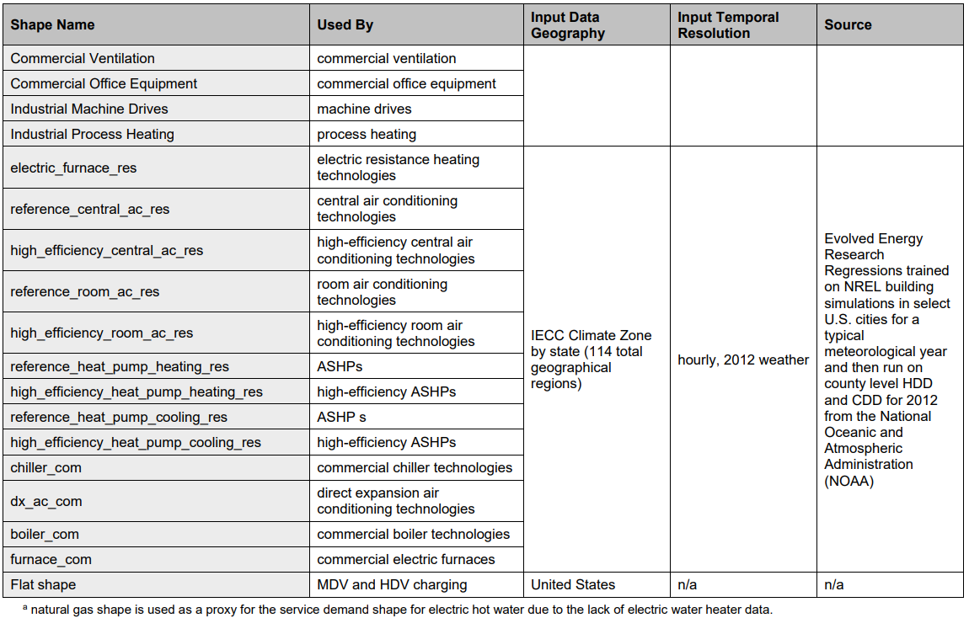
Load shape sources, continued
List compiled for NREL EFS study

Slide 35
Supply-side data
Data Category | Data Description | Supply Node | Source
Resource Potential | Binned resource potential (GWh) by state with associated resource performance (capacity factors) and transmission costs to reach load | Transmission – sited Solar PV; Onshore Wind; Offshore Wind; Geothermal | (Eurek et al. 2017)
Resource Potential | Binned resource potential of biomass resources by state with associated costs | Biomass Primary – Herbaceous; Biomass Primary – Wood; Biomass Primary – Waste; Biomass Primary – Corn | (Langholtz, Stokes, and Eaton 2016)
Resource Potential | Binned annual carbon sequestration injection potential by state with associated costs | Carbon Sequestration | (U.S. Department of Energy: National Energy Technology Laboratory 2017)
Resource Potential | Domestic production potential of natural gas | Natural Gas Primary – Domestic | (U.S. Energy Information Administration 2019)
Resource Potential | Domestic production potential of oil | Oil Primary – Domestic | (U.S. Energy Information Administration 2019)
Product Costs | Commodity cost of natural gas at Henry Hub | Natural Gas Primary – Domestic | (U.S. Energy Information Administration 2019)
Product Costs | Undelivered costs of refined fossil products | Refined Fossil Diesel; Refined Fossil Jet Fuel; Refined Fossil Kerosene; Refined Fossil Gasoline; Refined Fossil LPG | (U.S. Energy Information Administration 2019)
Product Costs | Commodity cost of Brent oil | Oil Primary – Domestic; Oil Primary - International | (U.S. Energy Information Administration 2019)
Delivery Infrastructure Costs | AEO transmission and delivery costs by EMM region | Electricity Transmission Grid; Electricity Distribution Grid | (U.S. Energy Information Administration 2019)
Delivery Infrastructure Costs | AEO transmission and delivery costs by census division and sector | Gas Transmission Pipeline; Gas Distribution Pipeline | (U.S. Energy Information Administration 2019)
Delivery Infrastructure | AEO delivery costs by fuel product | Gasoline Delivery; Diesel Delivery; Jet Fuel; LPG Fuel Delivery; Kerosene Delivery | (U.S. Energy Information Administration 2019)
Note: Updates are underway as new data becomes available from literature.

Slide 36
Supply-side data continued
Data Category | Data Description | Supply Node | Source
Technology Cost and Performance | Renewable and conventional electric technology installed cost projections | Nuclear Power Plants; Onshore Wind Power Plants; Offshore Wind Power Plants; Transmission – Sited Solar PV Power Plants; Distribution – Sited Solar PV Power Plants; Rooftop PV Solar Power Plants; Combined – Cycle Gas Turbines; Coal Power Plants; Combined – Cycle Gas Power Plants with CCS; Coal Power Plants with CCS; Gas Combustion Turbines | (National Renewable Energy Laboratory 2019)
Technology Cost and Performance | Electric fuel cost projections including electrolysis and fuel synthesis facilities | Central Hydrogen Grid Electrolysis; Power – To – Diesel; Power – To – Jet Fuel; Power – To – Gas Production Facilities | (Capros et al. 2018)
Technology Cost and Performance | Hydrogen Gas Reformation costs with and without carbon capture | H2 Natural Gas Reformation; H2 Natural Gas Reformation w/CCS | (International Energy Agency GHG Programme 2017)
Technology Cost and Performance | Nth plant Direct air capture costs for sequestration and utilization | Direct Air Capture with Sequestration; Direct Air Capture with Utilization | (Keith et al. 2018)
Technology Cost and Performance | Gasification cost and efficiency of conversion including gas upgrading. | Biomass Gasification; Biomass Gasification with CCS | (G. del Alamo et al. 2015)
Technology Cost and Performance | Cost and efficiency of renewable Fischer-Tropsch diesel production. | Renewable Diesel; Renewable Diesel with CCS | (G. del Alamo et al. 2015)
Technology Cost and Performance | Cost and efficiency of industrial boilers | Electric Boilers; Other Boilers | (Capros et al. 2018)
Technology Cost and Performance | Cost and efficiency of other, existing power plant types | Fossil Steam Turbines; Coal Power Plants | (Johnson et al. 2006)
Note: Updates are underway as new data becomes available from literature.

